Slide 1

ACM INDIA SUMMER SCHOOL
IoT Simulators

Slide 2
What are Simulators?
Physical Systems(Sensors/Actuators)
Communication(Socket APIs)
Virtual Systems
Run Simulation
Performance Analysis(Graph etc)
A device that enables the operator to reproduce or represent under test conditions phenomena likely to occur in actual performance.
Types Of Simulators
Network Simulators : Used to simulate a specific layer or all of them present in network stack.
Example: COOJA , NS3 etc
Physical Simulators : Used to simulate physical(hardwares) like vehicles and drones.
Example: GAZEBO etc
Simulators Vs Emulators
Simulators are used to simulate the hardwares in a virtual environment.
Emulators work on a physical setup. Example- Mininet/Maxinet

Slide 3
Why to use Simulators?
Network connection plays a vital role as IoT is all about the data being communicated in faster speeds all the time. IoT architecture has to be tested in all kinds of network connectivity/speeds. To test this, virtual network simulators are mostly used to vary the network load, connectivity, stability etc.
Application Layer
Transport Layer
Network Layer
Data Link Layer
Physical Layer
To test the desired protocol(https/coap/mqtt/websocket)
Reassembly of the data segment TCP/UDP
To monitor the packets dropped/received(IPv4/IPv6)
Error detection (CRC, CSMA CA/CD)
To monitor the data rate or the radio transmission (Zigbee/Wi-Max etc)

Slide 4
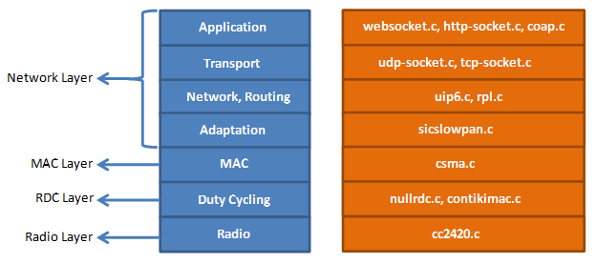
When to choose what? (Cooja/NS3/MiniNet)
Contiki plays the best role when working with power constrained networks.
Eg- 802.15.4
Best to be used with Zolertia motes, TelosB
RPL knowledge is necessary
Knowledge Of C is must
NS3 is suitable to test almost all real time network usage eg- Wi-Fi, LTE, FANET etc
Can be used for Drone/V2x simulation
Network /Link Performance Analysis is easy
Knowledge Of C++ and Python is must
MiniNet acts as an emulator for SDN networks
Supports
The Mininet-WiFi developers extended the functionality of Mininet by adding virtualized WiFi stations and access points based on the standard Linux wireless drivers and the 80211_hwsim wireless simulation driver.

Slide 5
Network Simulator (NS3)
Ns3 is a discrete event network simulator. It provides a simulation time and it jump from one event to another event. Ns3 contains various inbuilt libraries and modules within a directory. It supports Graphical user interface and python bindings.
Model Development
Develop by a Defined Channel and Mobility Models
Simulate a Model according to Events
Node and also Link Configuration
Define Node and Link Attributes (Data rate, Latency and also Packet Loss)
Manage Command Arguments
Simulation Execution
Building a File and also Analyze Outputs in a Command Prompt
Performance Analysis
Modeling Network by using NetAnim
Analyze the Performance under GNU plot
ns-3 | a discrete-event network simulator for internet systems (nsnam.org)

Slide 6
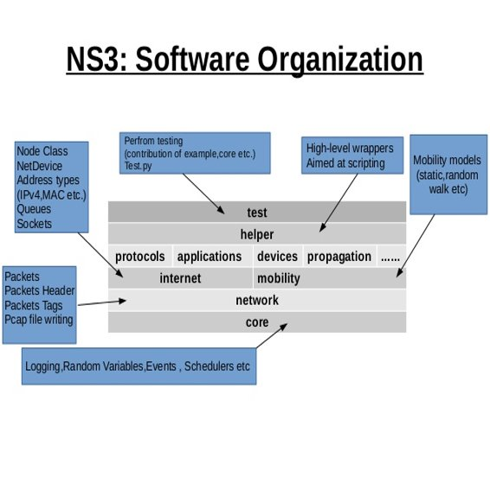
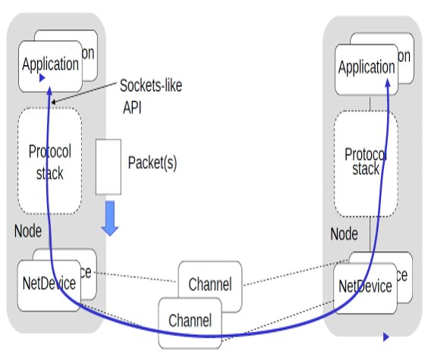
How Does NS3 Work?

Slide 7


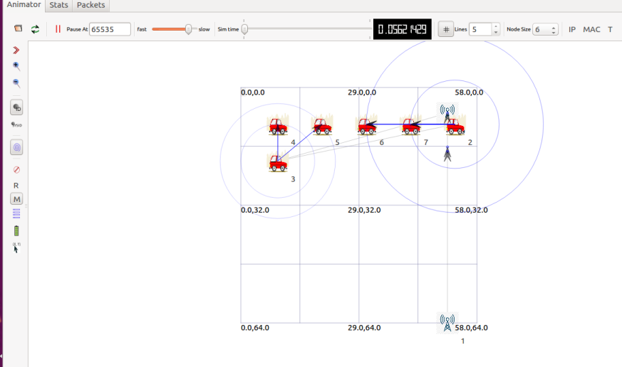
NS3 for LTE Simulation : V2X Usecase
LTE 4G Tower
NS3
LTE 4G Tower
Traffic Scenario with V2X (Vehicles to LTE towers) communication

